Slide 1
Subset-Sum Problem
From: Design & Analysis of Algorithm
By Anany Levitin

Slide 2
Subset-Sum Problem
In the subset-sum problem, We have to find a subset of a given set A = {a1, . . . , an} of n positive integers whose sum is equal to a given positive integer d.
For example, for A = {1, 2, 5, 6, 8} and d = 9, there are two solutions: {1, 2, 6} and {1, 8}. Of course, some instances of this problem may have no solutions.
It is convenient to sort the set’s elements in increasing order. So, we will assume that a1< a2 < . . . < an.
The state-space tree can be constructed as a binary tree
The root of the tree represents the starting point, with no decisions about the given elements made as yet.
Its left and right children represent, respectively, inclusion and exclusion of a1 in a set being sought.

Slide 3

Subset-Sum Problem
So going to the left from a node of the first level corresponds to inclusion of a2 while going to the right corresponds to its exclusion, and so on.
Thus, a path from the root to a node on the i^{th} level of the tree indicates which of the first i numbers have been included in the subsets represented by that node.
We record the value of s, the sum of these numbers, in the node.
If s is equal to d, we have a solution to the problem. We can either report this result and stop or, if all the solutions need to be found, continue by backtracking to the node’s parent.
If s is not equal to d, we can terminate the node as nonpromising if either of the following two inequalities holds:

Slide 4
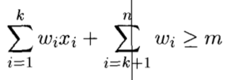

Constraint for State space tree exploration
Following is the necessary condition for further exploration in State Space Tree
Following is the necessary condition for stopping exploration in State Space Tree

Slide 5
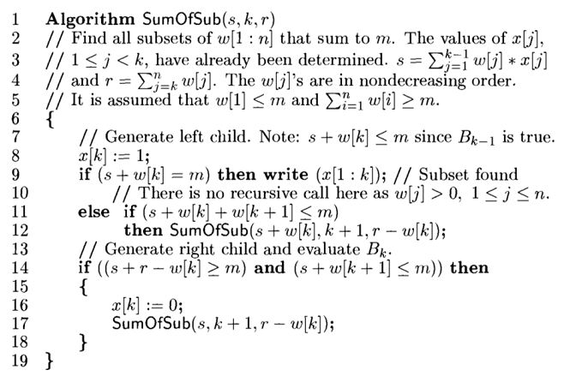
Algorithm for SumofSubset Problem

Slide 6
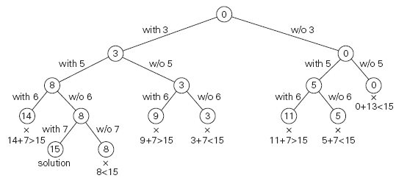
A = {3, 5, 6, 7} and d = 15 of the subset-sum problem.
The number inside a node is the sum of the elements already included in the subsets represented by the node. The inequality below a leaf indicates the reason for its termination.

